Slide 1
RESTAURANT OFFICIAL WEBPAGE
Presented By:
1. CHEEMALA VIJAYALAKSHMI -20RU1A0415
2. BOGGULA BHAVITHA -20RU1A0407
3. GALI JHANSI -20RU1A0422
4. VAKATI KUSUMA -20RU1A0457
Guided By: Hrishikesh Mahure and Ankit Dixit

Slide 2
OUTLINE
Abstract
Problem Statement (Should not include solution)
Aims , Objective & Proposed System/Solution
System Design
System Development Approach(Technology Used)
Algorithm & Deployment
Conclusion
References
Future Scope

Slide 3
Abstract
This restaurant website project aims to create an engaging and user-friendly online platform for a dining establishment. The website will serve as a digital storefront, offering visitors access to essential information such as the menu, location, hours of operation, and the ability to make reservations. Additionally, the site will incorporate visually appealing design elements and high-quality images to showcase the restaurant's ambiance and cuisine. Features such as online ordering, customer reviews, and an interactive map for directions will enhance the overall user experience. The project's primary objective is to enhance the restaurant's online presence, attract more customers, and streamline the reservation and ordering processes, ultimately contributing to the restaurant's success in the digital age.

Slide 4
Problem Statement
Design and develop a user-friendly restaurant webpage that provides essential information, an enticing menu, easy online reservation options, and a visually appealing representation of the restaurant's ambiance and cuisine, aiming to enhance customer engagement and increase reservations while maintaining a seamless user experience across various devices.

Slide 5
Proposed Solution
User-Friendly Interface
Menu Presentation
Online Reservation System
Visual Content
Responsive Design
Contact Information
Reviews and Testimonials
Special Offers and Events
Social Media Integration
Online Ordering
Accessibility and SEO
Analytics and Feedback
Security

Slide 6
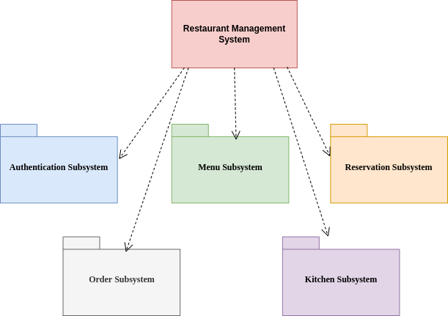
System Architecture

Slide 7
System Deployment Approach
The front end is designed using of HTML, PHP, CSS, JAVA script
HTML:
HTML or Hypertext Markup Language is the main markup language for creating web pages and other information that can be displayed in a web browser. HTML is written in the form of HTML elements consisting of tags enclosed in angle brackets(like), within the web page content. HTML tags most commonly come in pairs like <h1> and </h1>, although some tags represent empty elements and so are unpaired.

Slide 8
Algorithm & Deployment
Algorithm Overview:
Define project goals and scope
Gather requirements
Plan website structure
Select technology stack
Design user interface
Front-end Development
Database integration
Implement key feature
Testing and Quality assurance
Monitoring analytics
Deployment Overview:
Hosting provider
Domain registration
Prepared for Deployment
Setup Hosting Environment
Domain configuration
Upload files
Secure the website
Monitoring and maintenance
Performance optimization

Slide 9
Future scope
The primary scope of the restaurant management system project is well depicted on the user case diagrams that are well showcased in this report. However, the central system functionalities of the restaurant management system comprise generating reports, inventories, employee records, and managing orders.

Slide 10
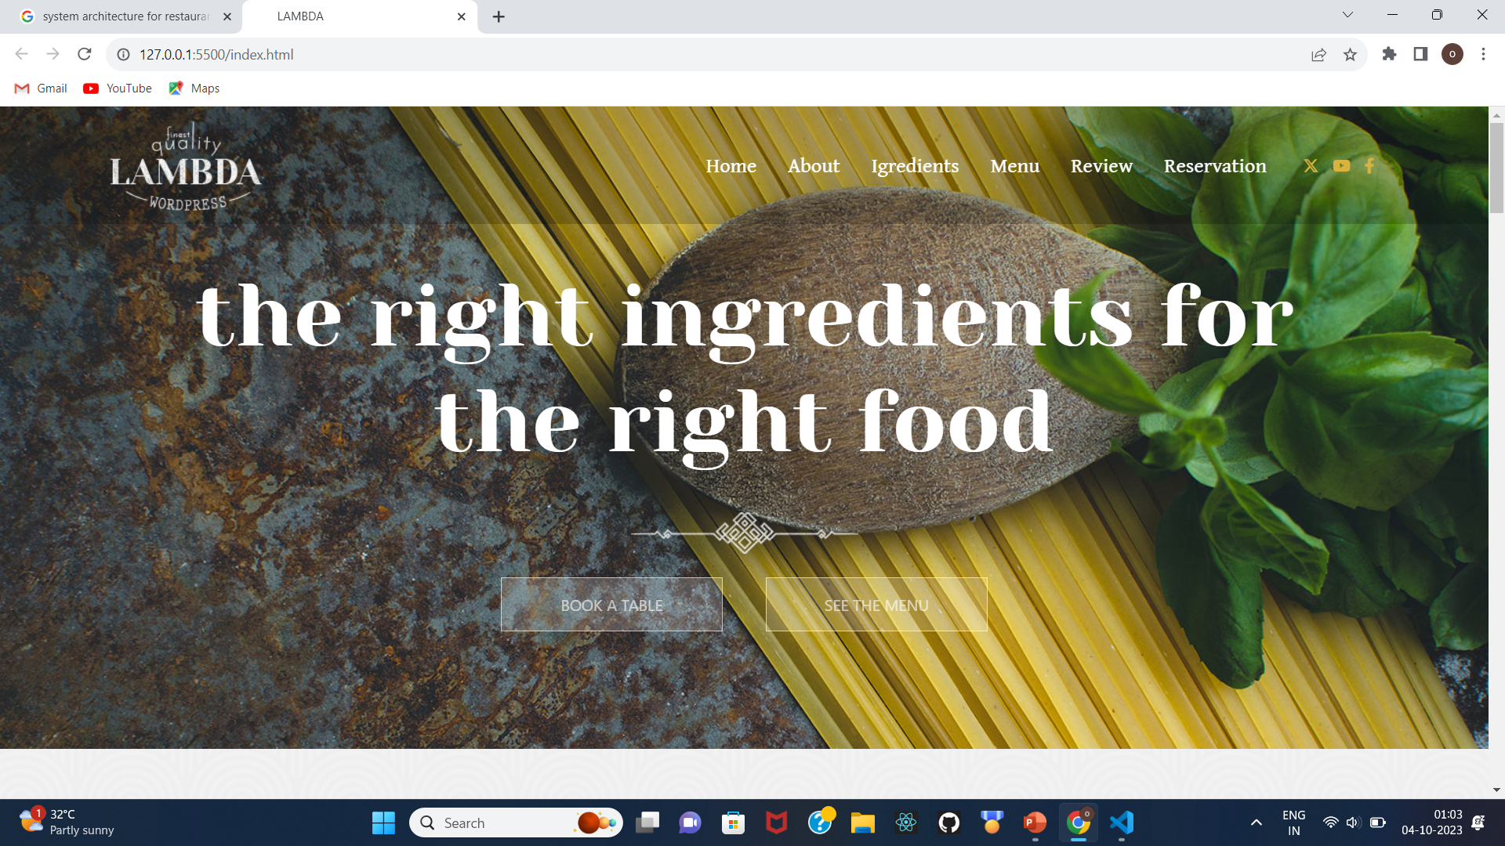
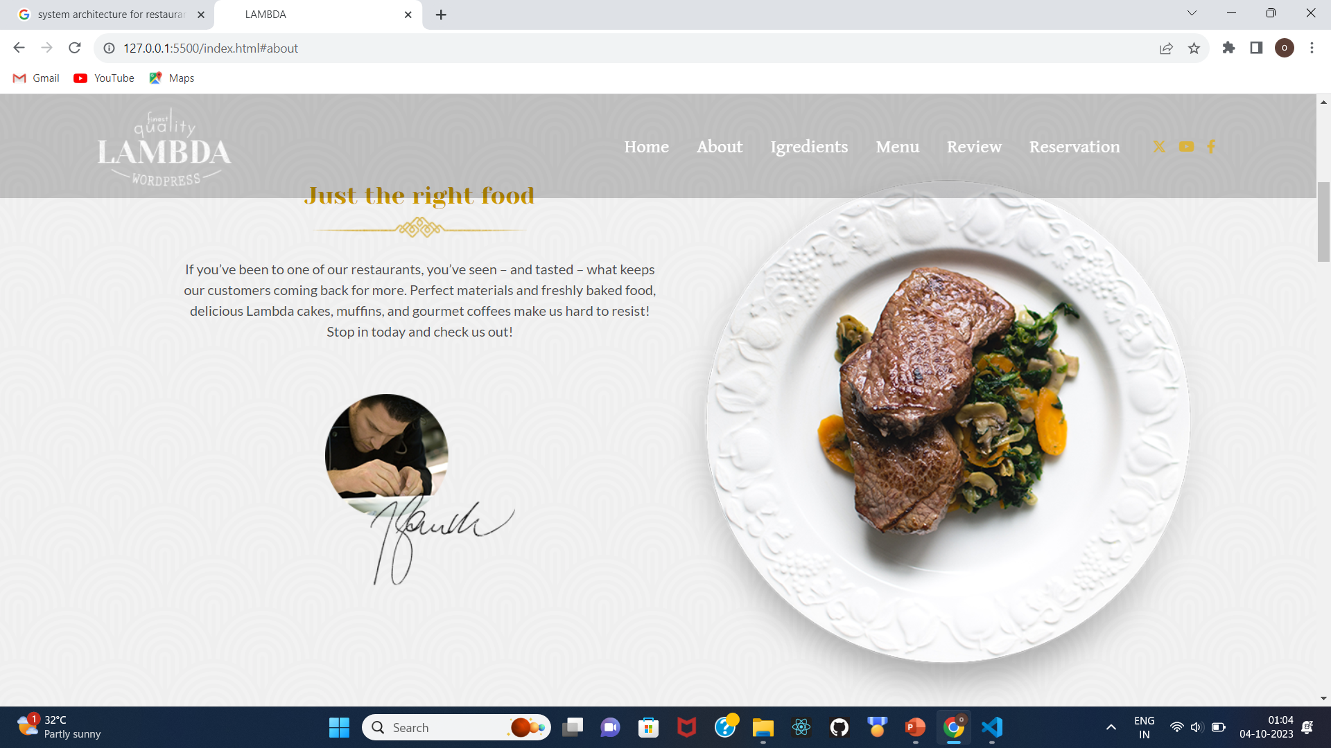
sample screenshots

Slide 11
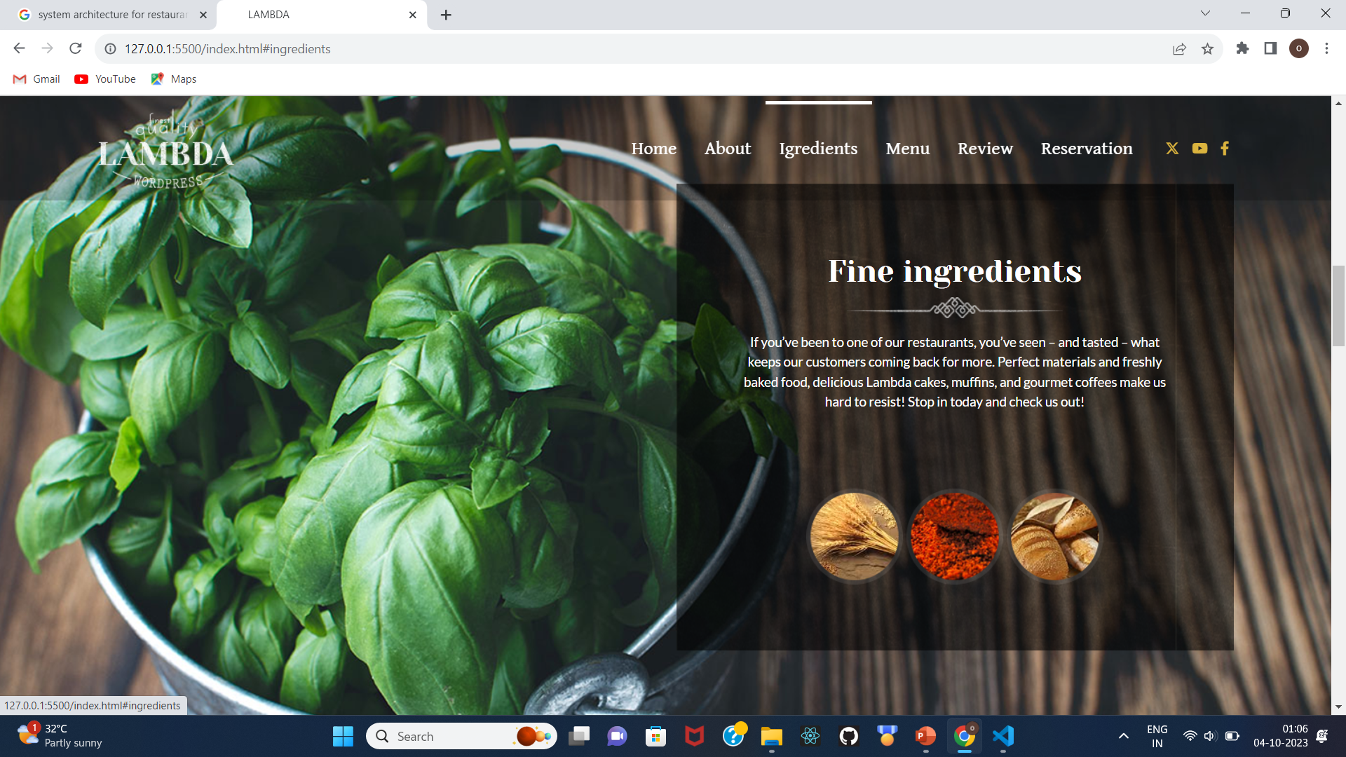
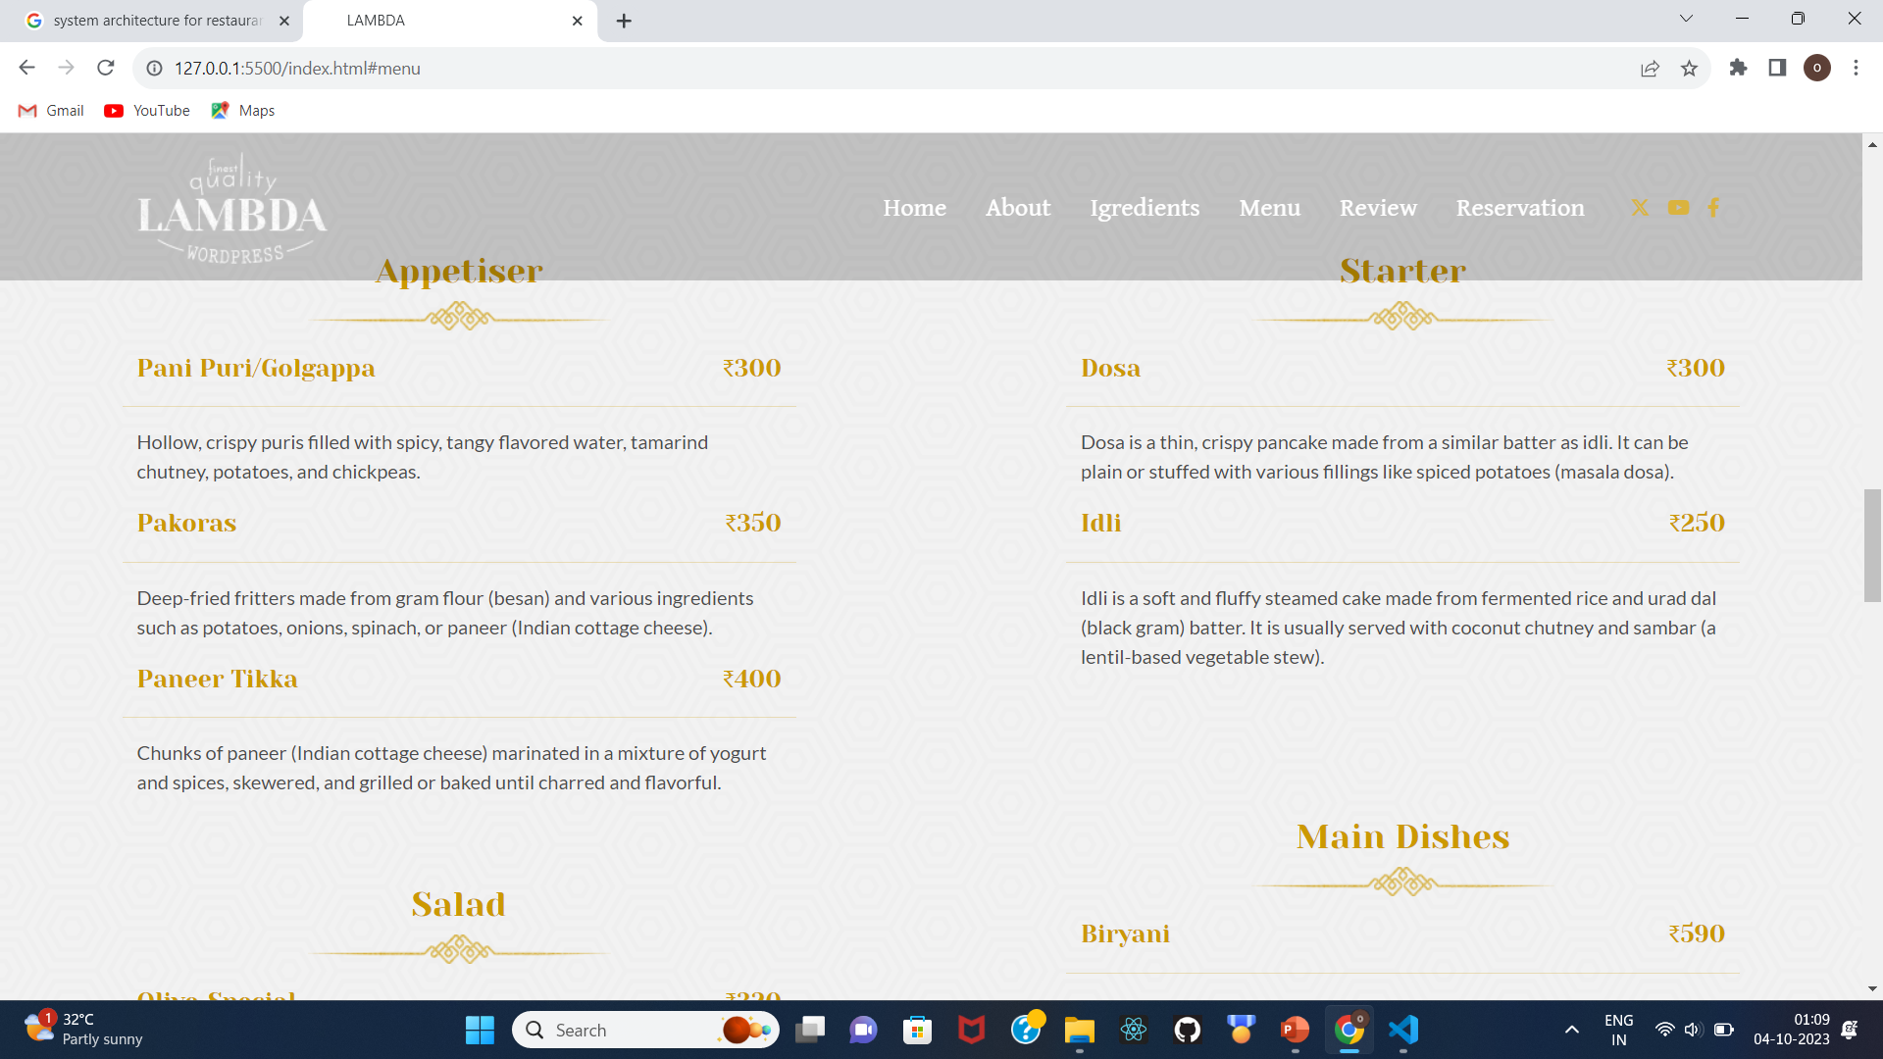

Slide 12
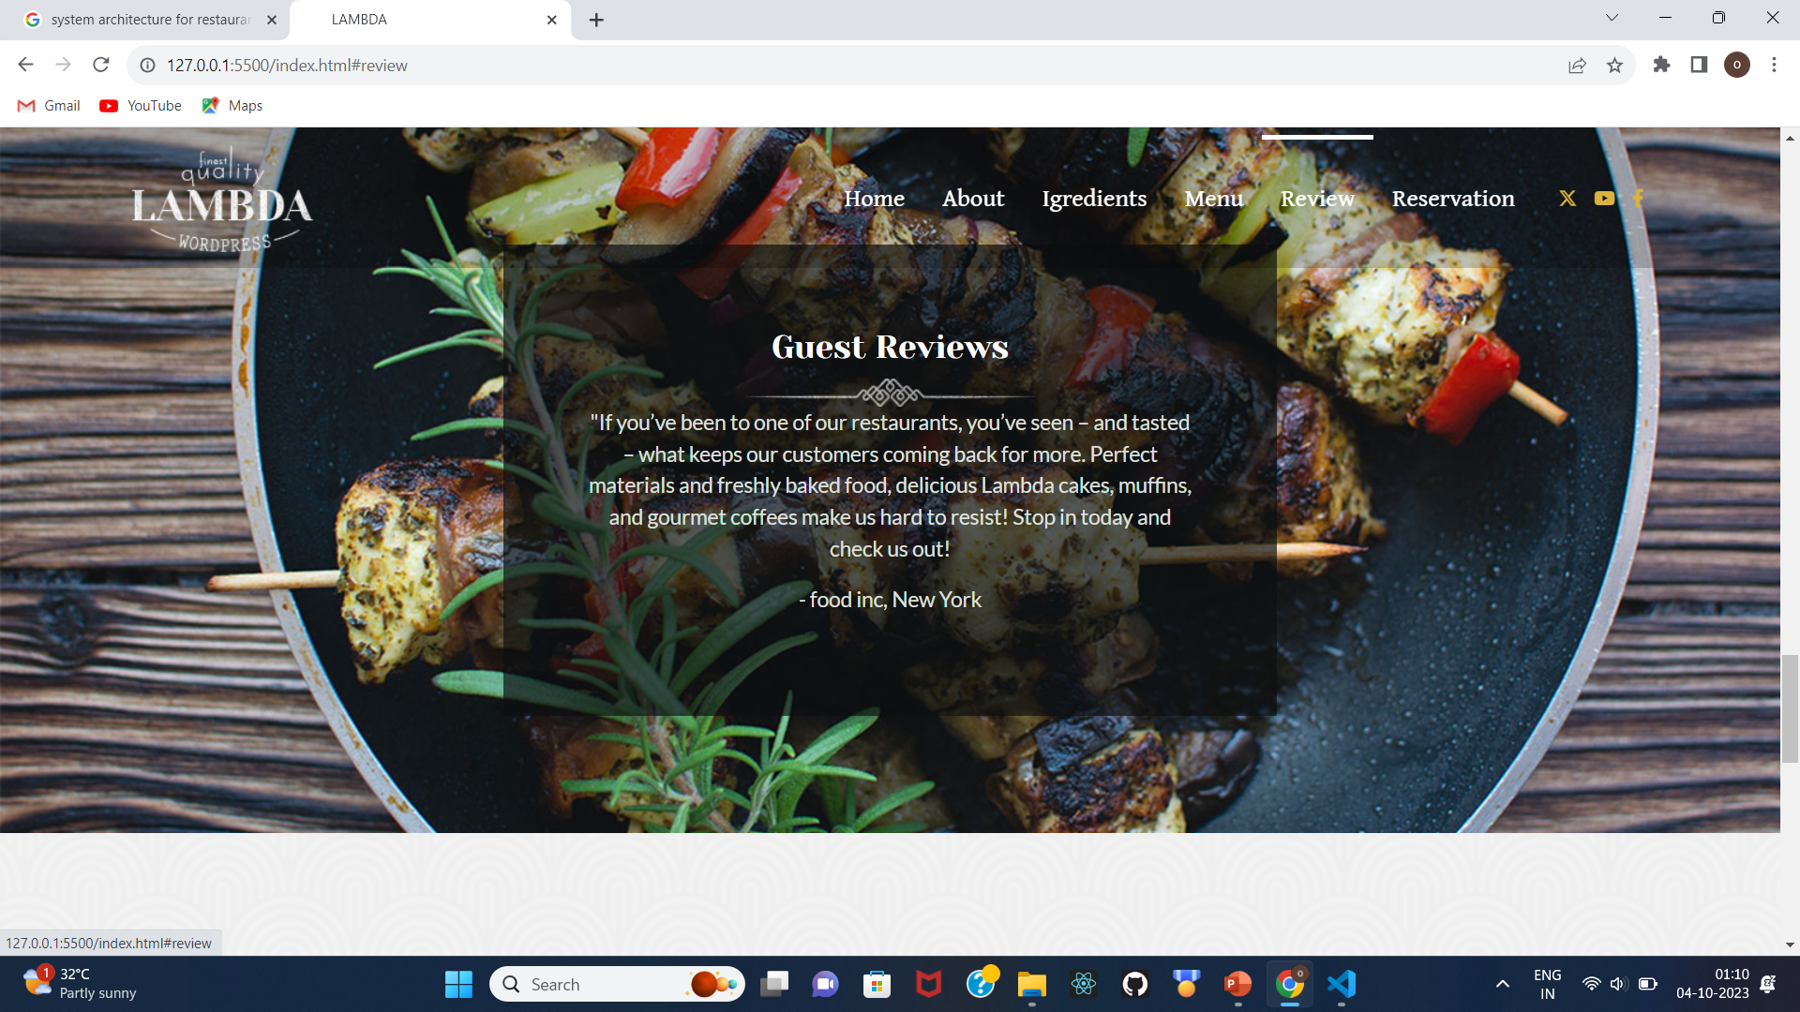
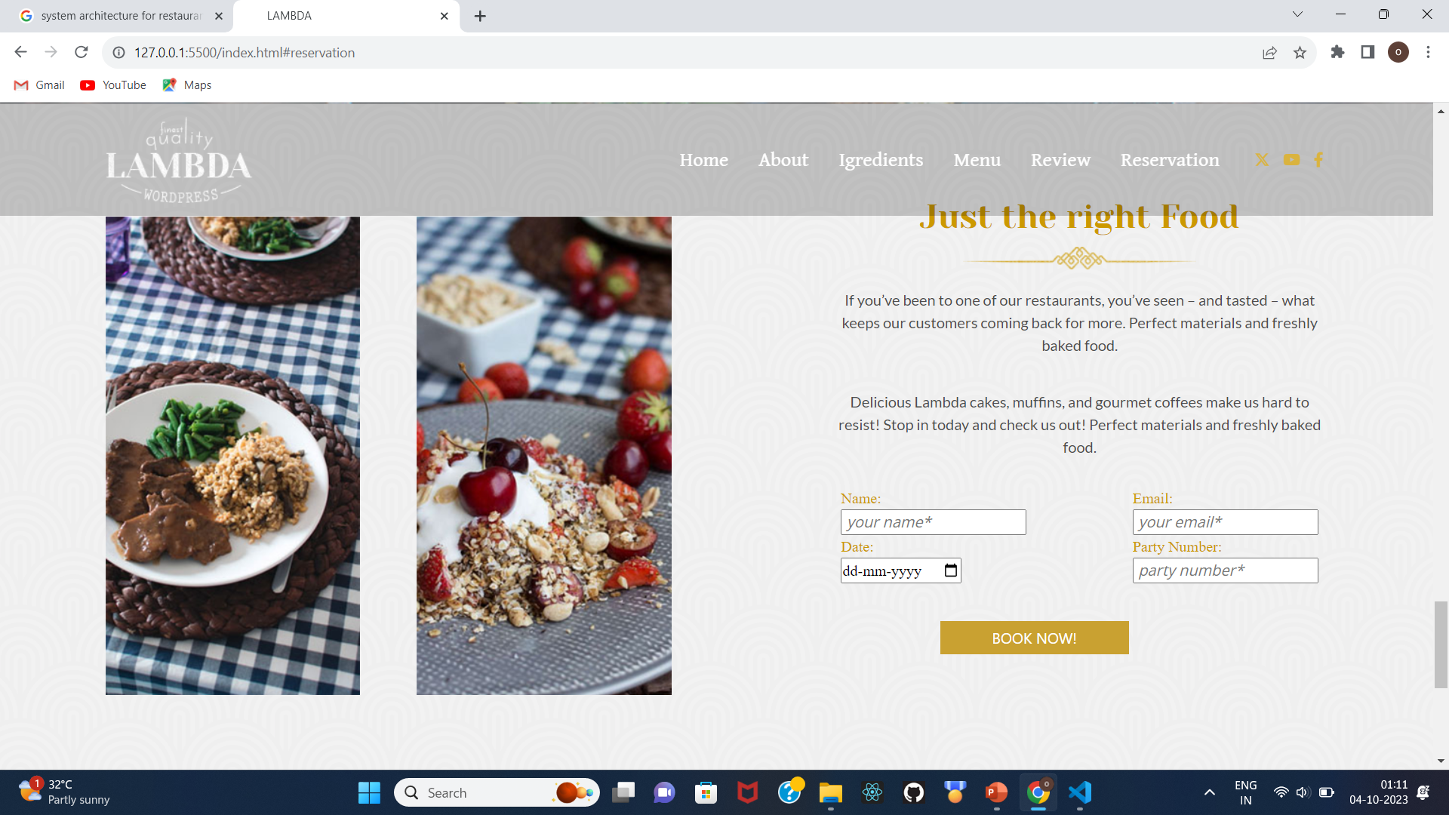

Slide 13
Conclusion
In conclusion, a restaurant web page project is a multifaceted endeavor that involves the creation of a digital presence for a restaurant. This digital platform serves various purposes, from providing essential information to potential customers to offering online ordering and reservation capabilities.

Slide 14
THANK YOU

